Slide 1
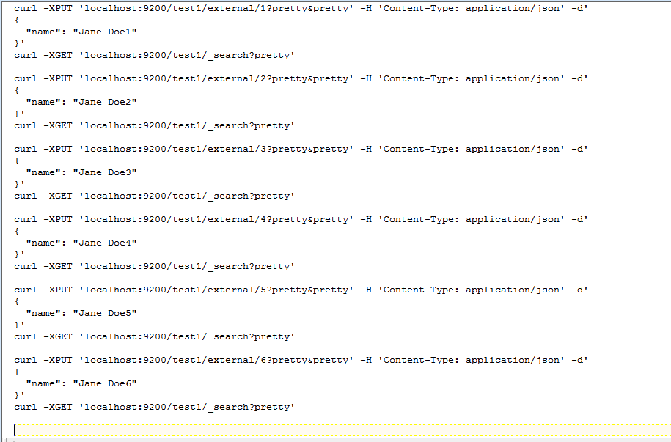

Slide 2
Test 1
Do a search immediately after indexing each record 1 by 1

Slide 3
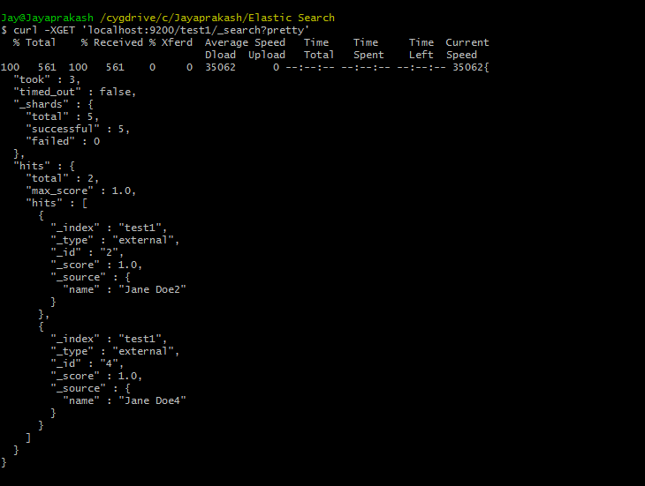

Slide 4
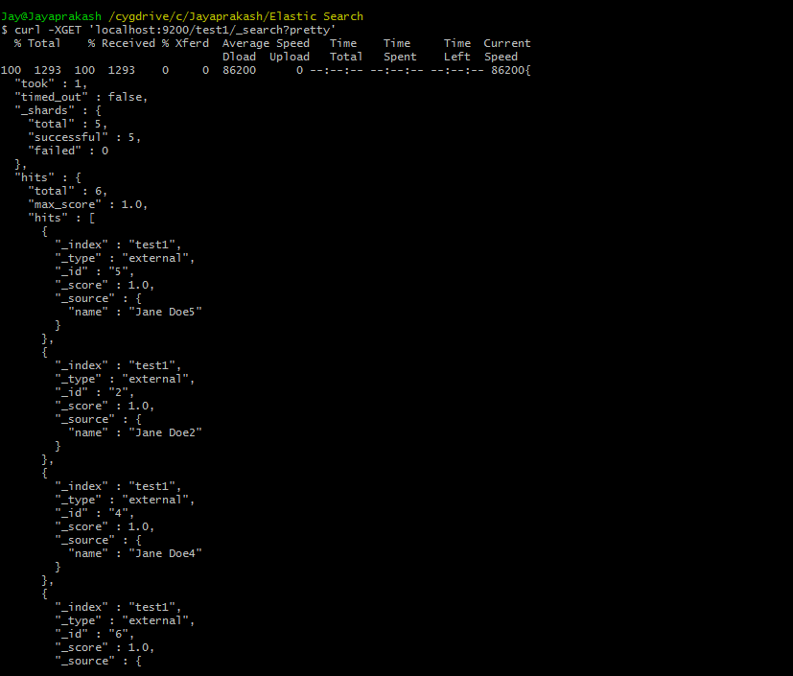

Slide 5
Test 2
Index and Search with a small file and calculate the response time
Index and Search with comparatively a large file and calculate the response time
Data in second file is 4 times larger than the first file
Compare both the response times
Note – Both the Search queries are written to fetch the same unique record

Slide 6
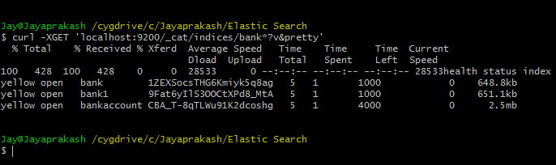
Data in index bankaccount is 4 times larger than index bank

Slide 7
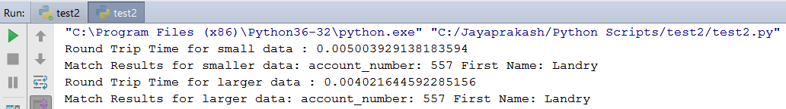
But the response time after executing both the search queries from the same python script is almost the same
"C:\Program Files (x86)\Python36-32\python.exe" "C:/Jayaprakash/Python Scripts/test2/test2.py"
Round Trip Time for small data : 0.005003929138183594
Match Results for smaller data: account_number: 557 First Name: Landry
Round Trip Time for larger data : 0.004021644592285156
Match Results for larger data: account_number: 557 First Name: Landry

